Slide 1
Coursera Capstone IBM Applied Data Science Capstone New Shopping Mall Opening in Brooklyn, NY, United States of America
Done by: Hasan Ali Mohamed Taresh
April, 2020

Slide 2
Business Problem
Objective: To analyze and choose the best locations in Brooklyn (a borough of New York City, USA) to open a new shopping mall.
Business Question: If a property developer is planning to open a new shopping mall in Brooklyn, in New York City, USA, where is the best recommended area that should be chosen to build the mall on?

Slide 3
Data
Data Required:
A list of neighborhoods in Brooklyn.
Coordinates of the neighborhoods.
Venue data, particularly data related to shopping malls.
Data Sources:
Wikipedia Page: https://en.wikipedia.org/wiki/Category:Neighborhoods_in_Brooklyn.
Geocoder package for coordinates.
Foursquare API for venue data.

Slide 4
Methodology
Web scraping Wikipedia page for neighborhoods list.
Get latitude and longitude coordinates using Geocoder.
Use Foursquare API to get venue data.
Group data by neighborhood and taking the mean of the frequency of occurrence of each venue category.
Filter venue category by Shopping Mall.
Perform clustering on the data by using k-means clustering.
Visualize the clusters in a map using Folium.

Slide 5
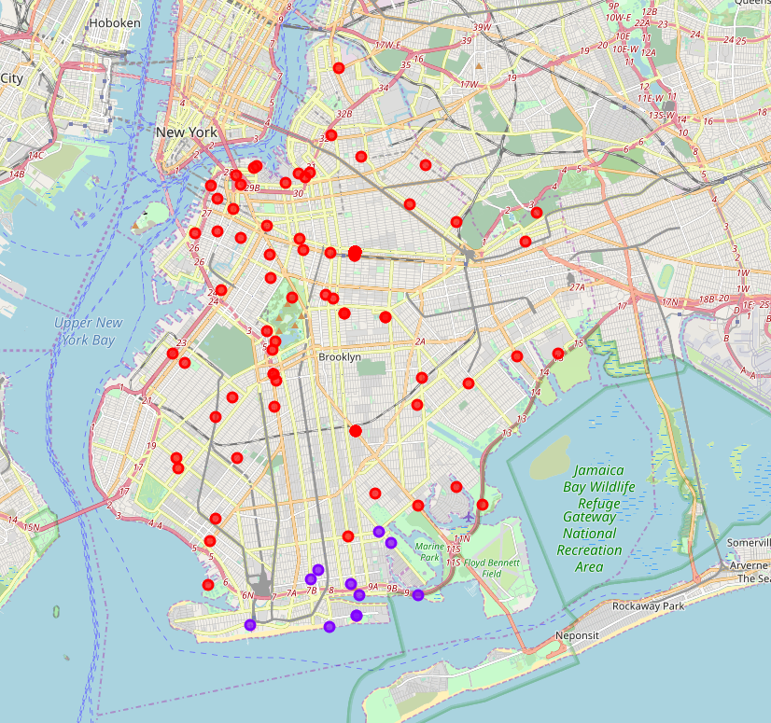
Results
Neighborhoods are categorized into 2 clusters:
Cluster 0: Neighborhoods with no existence of shopping malls.
Cluster 1: Neighborhoods with low to moderate number of shopping malls.

Slide 6
Discussion
After observation of data, we noticed the following:
Most of shopping malls are concentrated on cluster 1, which is in the lower side of Brooklyn close to the beach.
The upper part of Brooklyn has few to no shopping malls in the neighborhoods.
This represents a great opportunity and high potential areas to open new shopping malls as there is very little to no competition from existing malls.
Meanwhile, shopping malls in cluster 1 are likely suffering from intense competition due to oversupply and high concentration of shopping malls.

Slide 7
Conclusion
Answer to Business Question: The neighborhoods in cluster 0 are the most preferred locations to open a new shopping mall.
Findings of this project will help the relevant stakeholders to capitalize on the opportunities on high potential locations while avoiding overcrowded areas in their decisions to open a new shopping mall.

Slide 8

Thanks!

